Slide 1

Bachelor of Technology
Capstone Project Topic Approval Presentation
Academic Year 2025-26
Semester VII
SVKM’s NMIMS
Mukesh Patel School of Technology Management and Engineering, Vile Parle, Mumbai- 400056
Department of Data Science
*

Slide 2
A PRESENTATION ON
“Understanding the Real-World Impact of UN Counterterrorism Through Data Science and NLP”
By
Prithvi Singh – J046 (70092200081)
Rahul Yanamandra – J047 (70092200058)
Suchir Thaokar – J065 (70092200057)
Under the guidance of
Dr. Siba Panda
*

Slide 3
Project Idea
Investigate the real-world impact of United Nations interventions (sanctions, CTED assessments, Security Council resolutions) on terrorism and economic outcomes.
Use data science and NLP to analyze both structured data and the actual content of UN documents.
*

Slide 4
Problem Statement
The effectiveness of UN interventions against terrorism is widely debated, but rarely evaluated using quantitative, data-driven methods.
This project aims to measure:
How UN actions influence terrorism rates and economic indicators (GDP, FDI, tourism, unemployment).
Whether the content, strength, or focus of UN resolutions (analyzed using NLP) correlates with changes in these outcomes.
*

Slide 5
Data Sources
UN Documents:
Security Council resolutions, CTED reports, sanctions lists (with full text for NLP)
https://www.un.org/securitycouncil/ctc/content/publications
Terrorism Data:
Global Terrorism Database (GTD)
https://www.start.umd.edu/data-tools/GTD
Economic Data:
World Bank (GDP, FDI, tourism, unemployment, population)
https://data360.worldbank.org/en/search?tab=all
*

Slide 6
What Hasn’t Been Done Yet
No existing NLP-based impact analysis of UNSC terrorism meetings.
Existing work is mostly policy-based or qualitative.
No models connecting resolution text content with GTD outcomes.
*

Slide 7
Implementation Plan
Data Collection: Gather structured and unstructured data from UN, GTD, World Bank.
Data Engineering: Harmonize countries, merge datasets, create intervention indicators.
NLP on UN Documents:
Extract sentiment, urgency, topics, and “strength” from full text of UN resolutions and CTED reports.
Analysis & Modeling:
Use statistical and causal inference models to link UN interventions and their textual content to changes in terrorism and economic metrics.
Visualization:
Present before/after trends, heatmaps, and NLP insights.
*

Slide 8
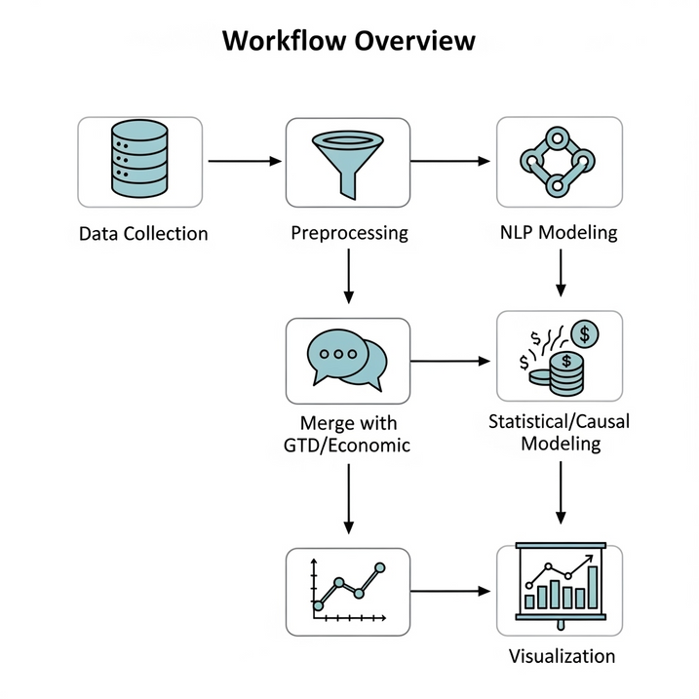
System Architecture
*

Slide 9
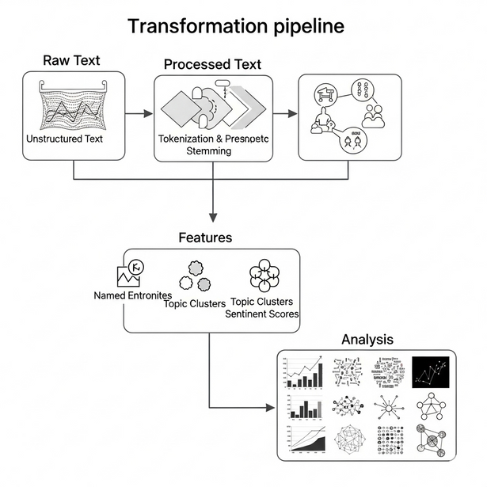
NLP Techniques to Be Used
Topic Modeling (e.g., BERTopic)
Sentiment Analysis (e.g., VADER, BERT)
Stance Detection (Support/Oppose/Neutral)
Text Strength Scoring (custom lexicons + LLMs)
Document Embedding with Sentence-BERT or LLMs
*

Slide 10
Expected Outcomes
Evidence-based assessment of UN effectiveness in reducing terrorism and supporting economic recovery.
Insights into how the tone, focus, or strength of UN documents (from NLP) affects real-world outcomes.
Actionable findings for policymakers and international agencies.
*

Slide 11
Research Publication
NLP-based insights from UN document analysis.
Preparation of a research paper for academic publication.
Targeting submission of a research paper for our data science capstone project.
Will document methodology, results, and policy implications.
*

Slide 12
THANK YOU
*

